Slide 1

Community Analysis
AI in Society: Bias and Fairness in Data, Networks and Algorithms

Slide 2

Social Community
[real-world] community
A group of individuals with common economic, social, or political interests or characteristics, often living in relative proximity.
Notes:
Community is “a group of densely interconnected nodes”
Ref: Y.-Y. Ahn, J. P. Bagrow, and S. Lehmann, "Communities and Hierarchical Organization of Links in Complex Networks", submitted, arxiv:0903.3178.
Community is “a group of TOPOLOGICALLY SIMILAR LINKS”
Ref: Y.-Y. Ahn, J. P. Bagrow, and S. Lehmann, "Communities and Hierarchical Organization of Links in Complex Networks", submitted, arxiv:0903.3178.

Slide 3
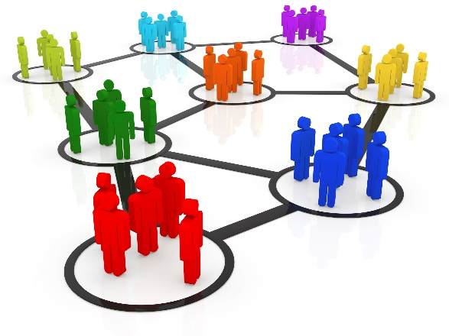
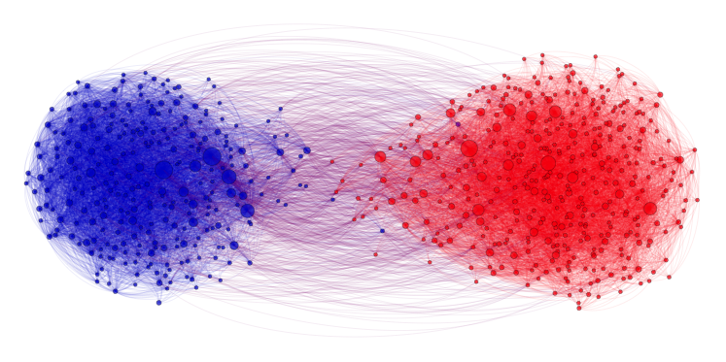
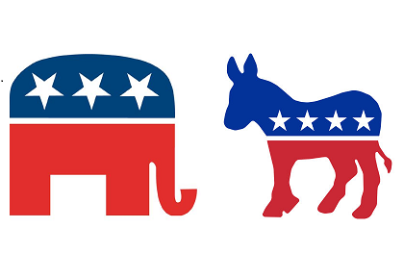
Why analyze communities?
Analyzing communities helps better understand users
Users form groups based on their interests
Groups provide a clear global view of user interactions
E.g., find polarization
Some behaviors are only observable in a group setting and not on an individual level
Some republican can agree with some democrats, but their parties can disagree
Notes:
Explicitly vs. implicitly formed groups

Slide 4
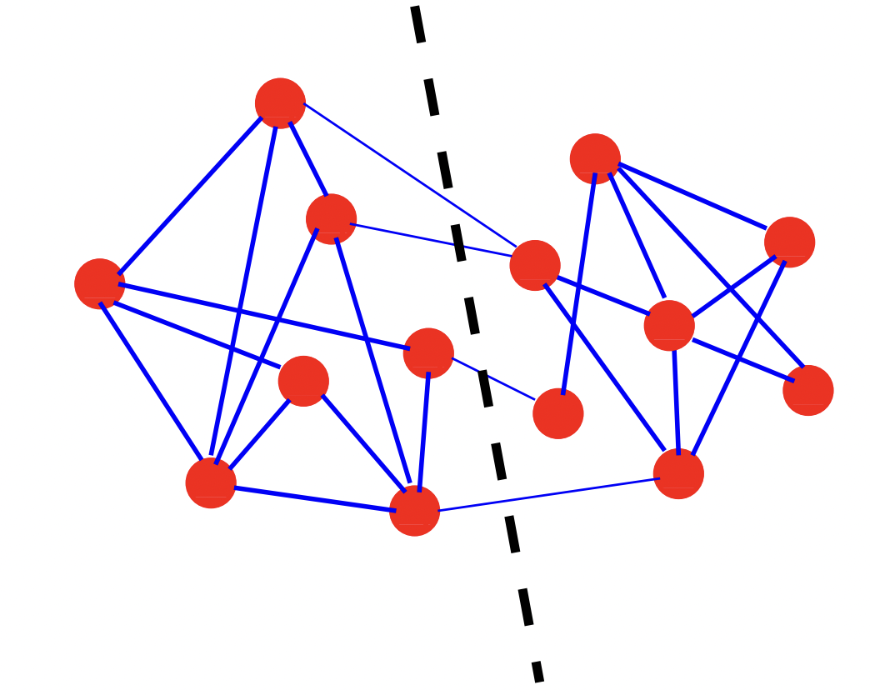
Fundamental to computer science as well
Graph partitioning is also seen in
Parallel computing
E.g., linear algebra - want to avoid communication between GPU or CPU cores
Circuit partitioning/layout
Serial algorithms (including differential equations)
Fortunato, 2009

Slide 5
Social Media Communities
Formation:
When like-minded users on social media form a link and start interacting with each other
More Formal Formation:
A set of at least two nodes sharing some interest, and
Interactions with respect to that interest.
Social Media Communities
Explicit (emic): formed by user subscriptions
Implicit (etic): implicitly formed by social interactions
Example: individuals calling Canada from the United States
Phone operator considers them one community for promotional offers
Other community names: group, cluster, cohesive subgroup, or module
Notes:
Explicitly vs. implicitly formed groups

Slide 6



Examples of Explicit Social Media Communities
Facebook has groups and communities. Users can
post messages and images,
can comment on other messages,
can like posts, and
can view activities of other users
In Google+, Circles represent communities
LinkedIn provides Groups and Associations.
Users can join professional groups where they can post and share information related to the group

Slide 7
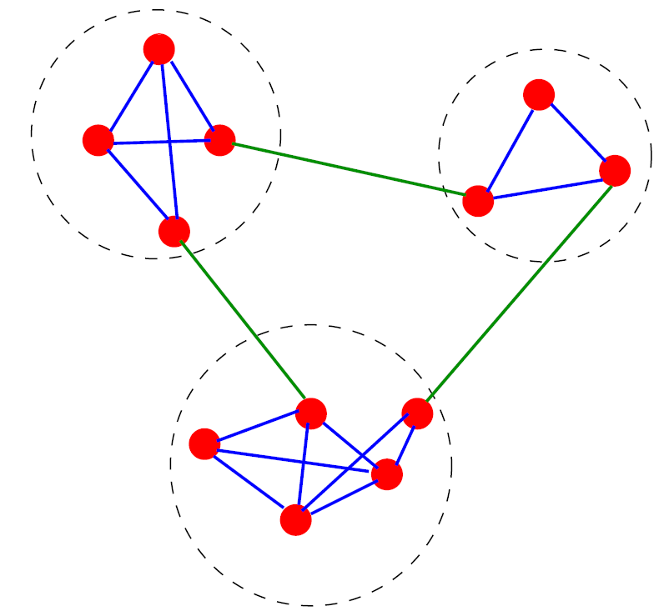
Finding Implicit Communities: An Example
A simple graph in which three implicit communities are found, enclosed by the dashed circles

Slide 8
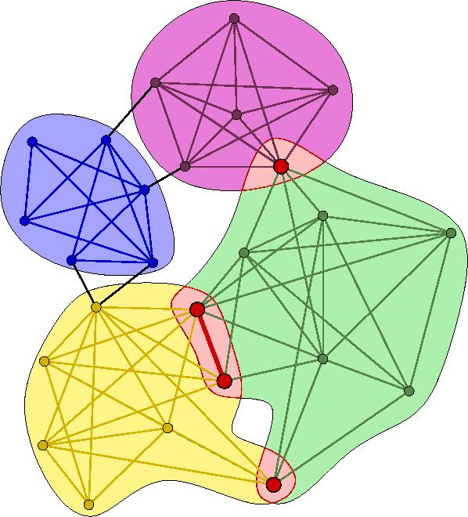
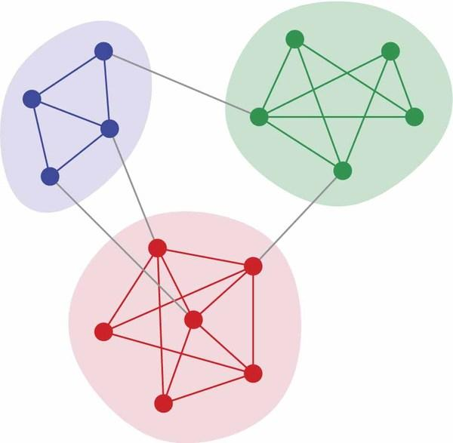
Overlapping vs. Disjoint Communities
Overlapping Communities
Disjoint Communities

Slide 9
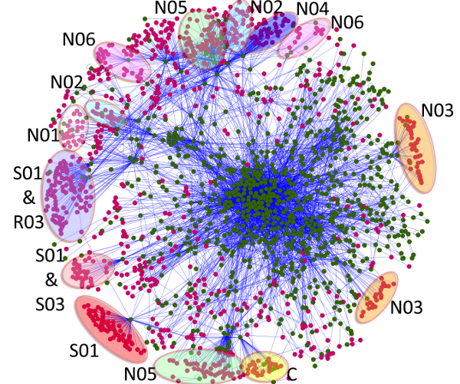
Implicit communities in other domains
Protein-protein interaction networks
Communities are likely to group proteins having the same specific function within the cell
World Wide Web
Communities may correspond to groups of pages dealing with the same or related topics
Metabolic networks
Communities may be related to functional modules such as cycles and pathways
Food webs
Communities may identify compartments

Slide 10
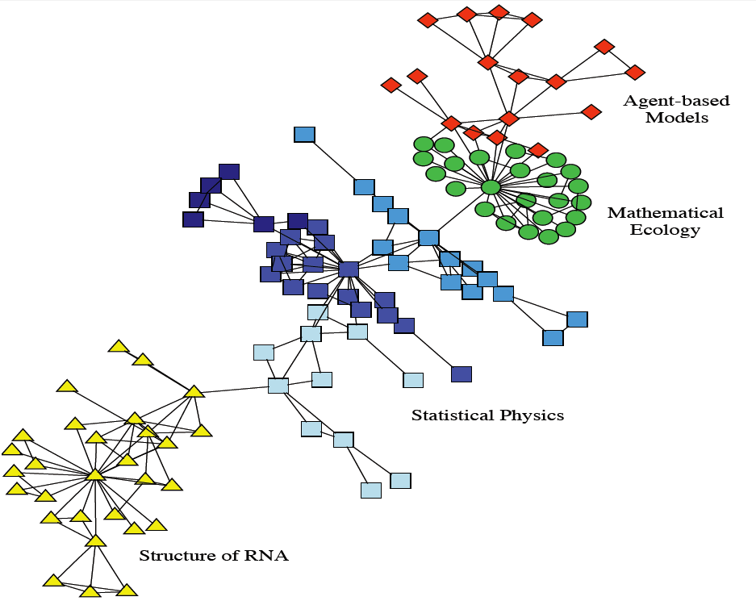
Real-world Implicit Communities
Collaboration network between scientists working at the Santa Fe Institute.
The colors indicate high level communities and correspond to research divisions of the institute

Slide 11
Community Detection

Slide 12
What is community detection?
The process of finding clusters of nodes (‘‘communities’’)
With Strong internal connections and
Weak connections between different communities
Ideal decomposition of a large graph
Completely disjoint communities
There are no interactions between different communities.
In practice,
find community partitions that are maximally decoupled.

Slide 13
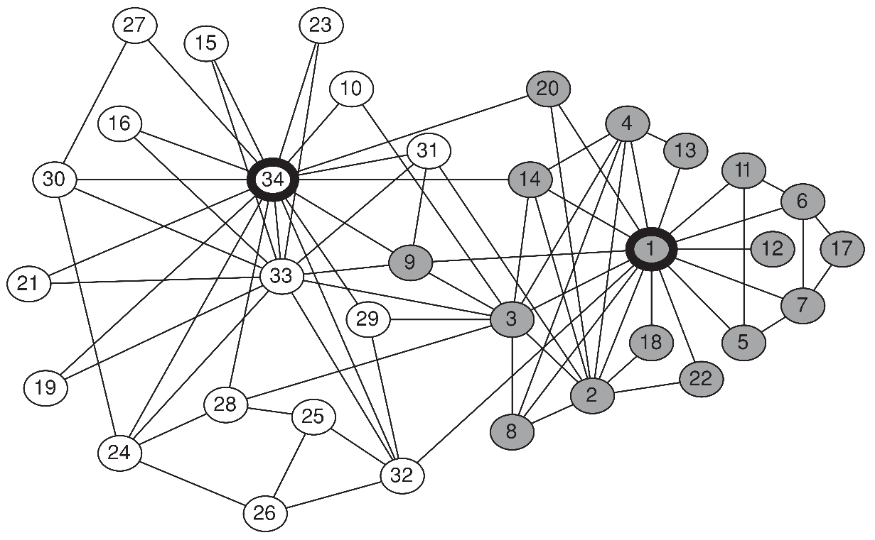
Why Detecting Communities is Important?
Zachary's karate club
Interactions between 34 members of a karate club
for over two years
The club members split into two groups (gray and white)
Disagreement between the administrator of the club (node 34) and the club’s instructor (node 1),
The members of one group left to start their own club
The same communities can be found using community detection

Slide 14
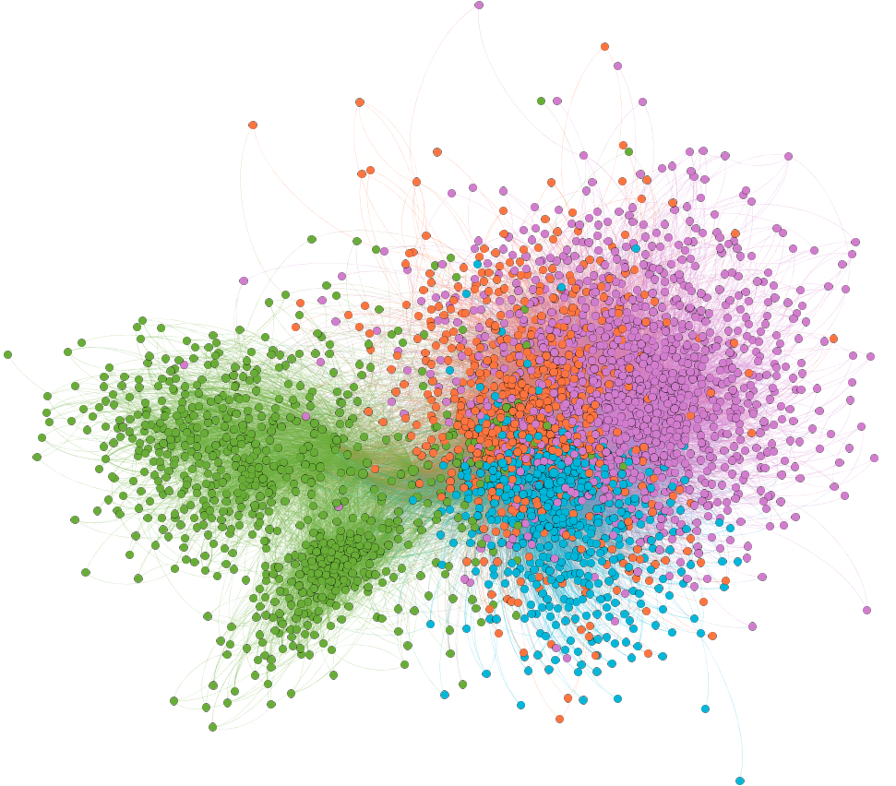
Why Community Detection?
Network Summarization
A community can be considered as a summary of the whole network
Easier to visualize and understand
Preserve Privacy
[Sometimes] a community can reveal some properties without releasing the individuals’ privacy information.
General (DE)
AfD (EN)
CDU (DE)
AfD (DE)

Slide 15
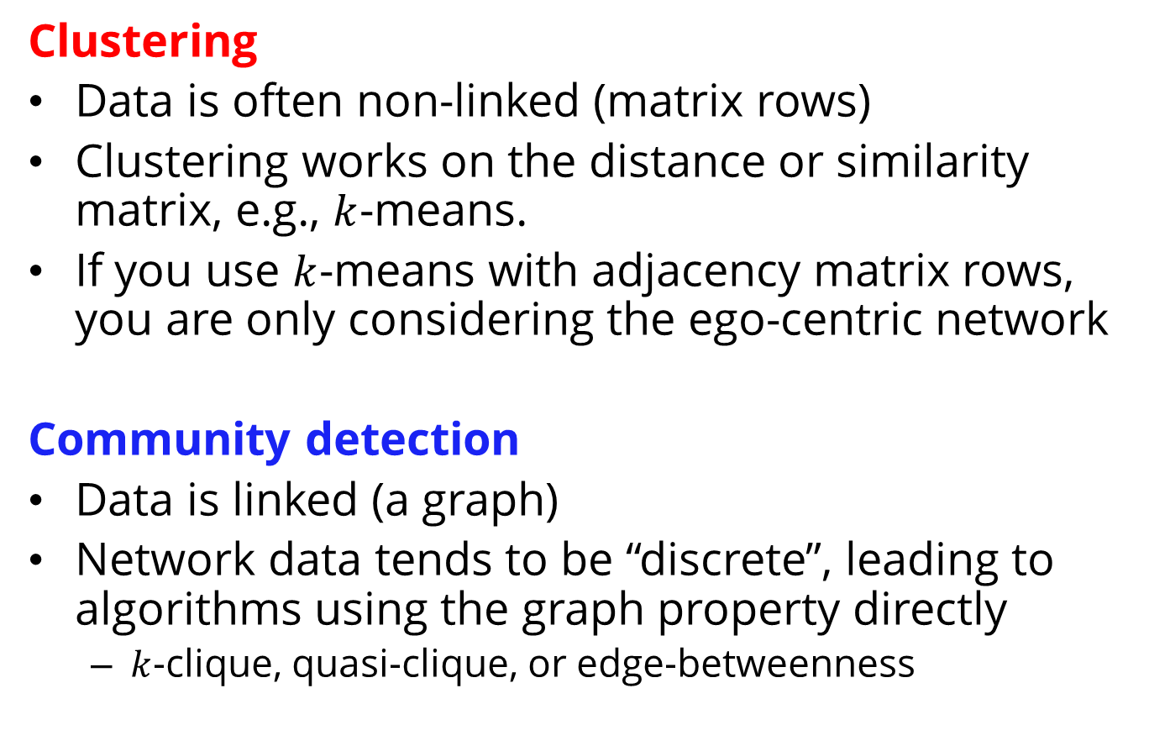
Community Detection vs. Clustering
Notes:
From Lei’s Slides

Slide 16
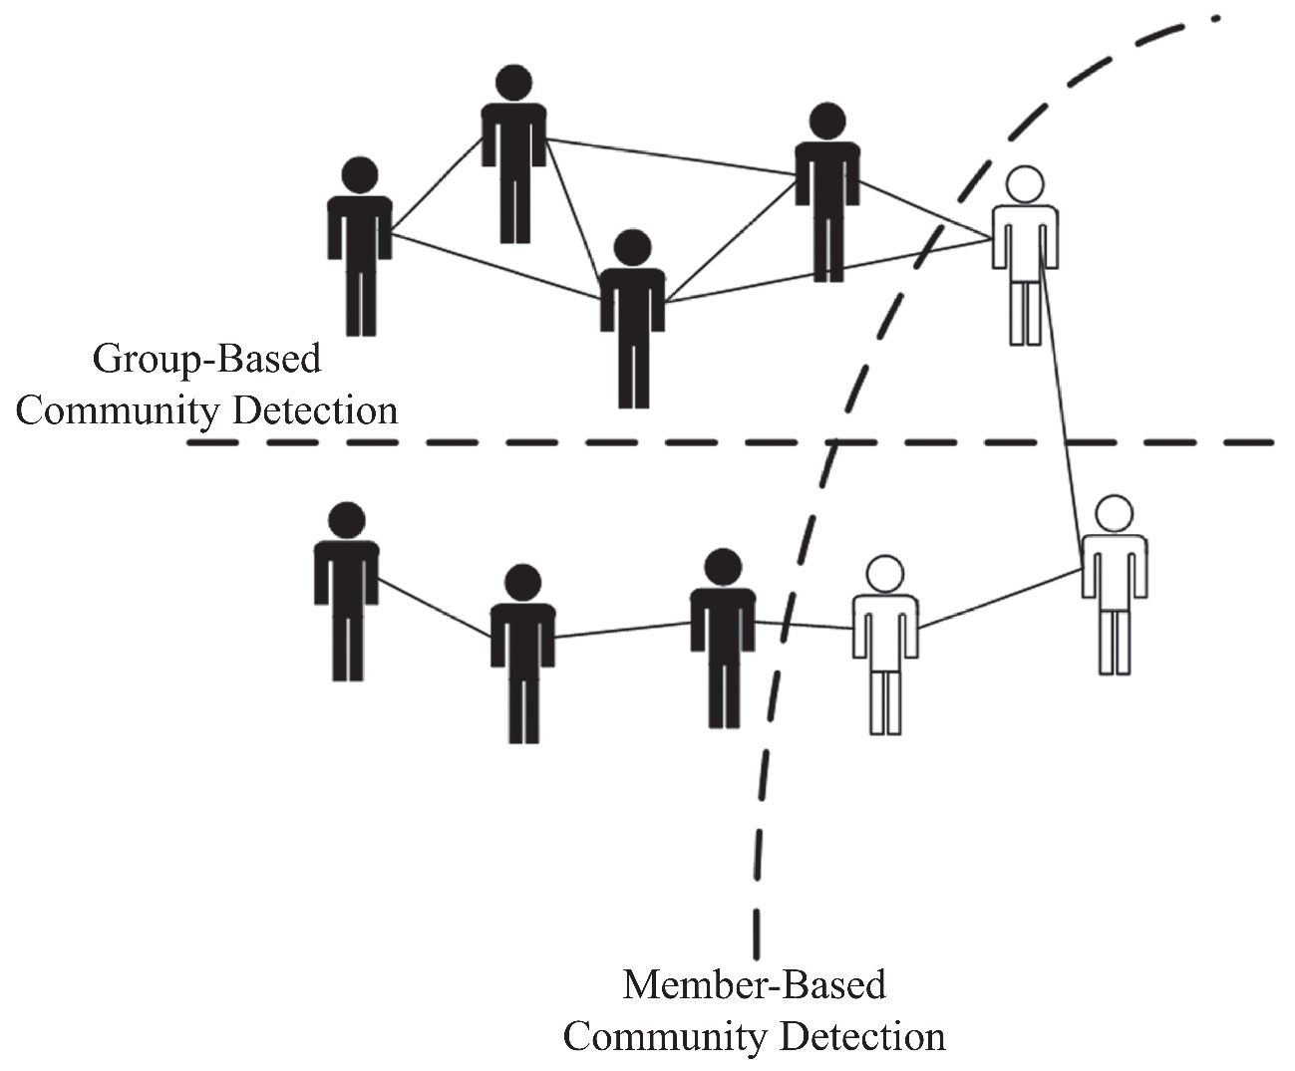
Community Detection Algorithms
Group Users based on Group attributes
Group Users based on Member
attributes

Slide 17
Member-Based Community Detection

Slide 18
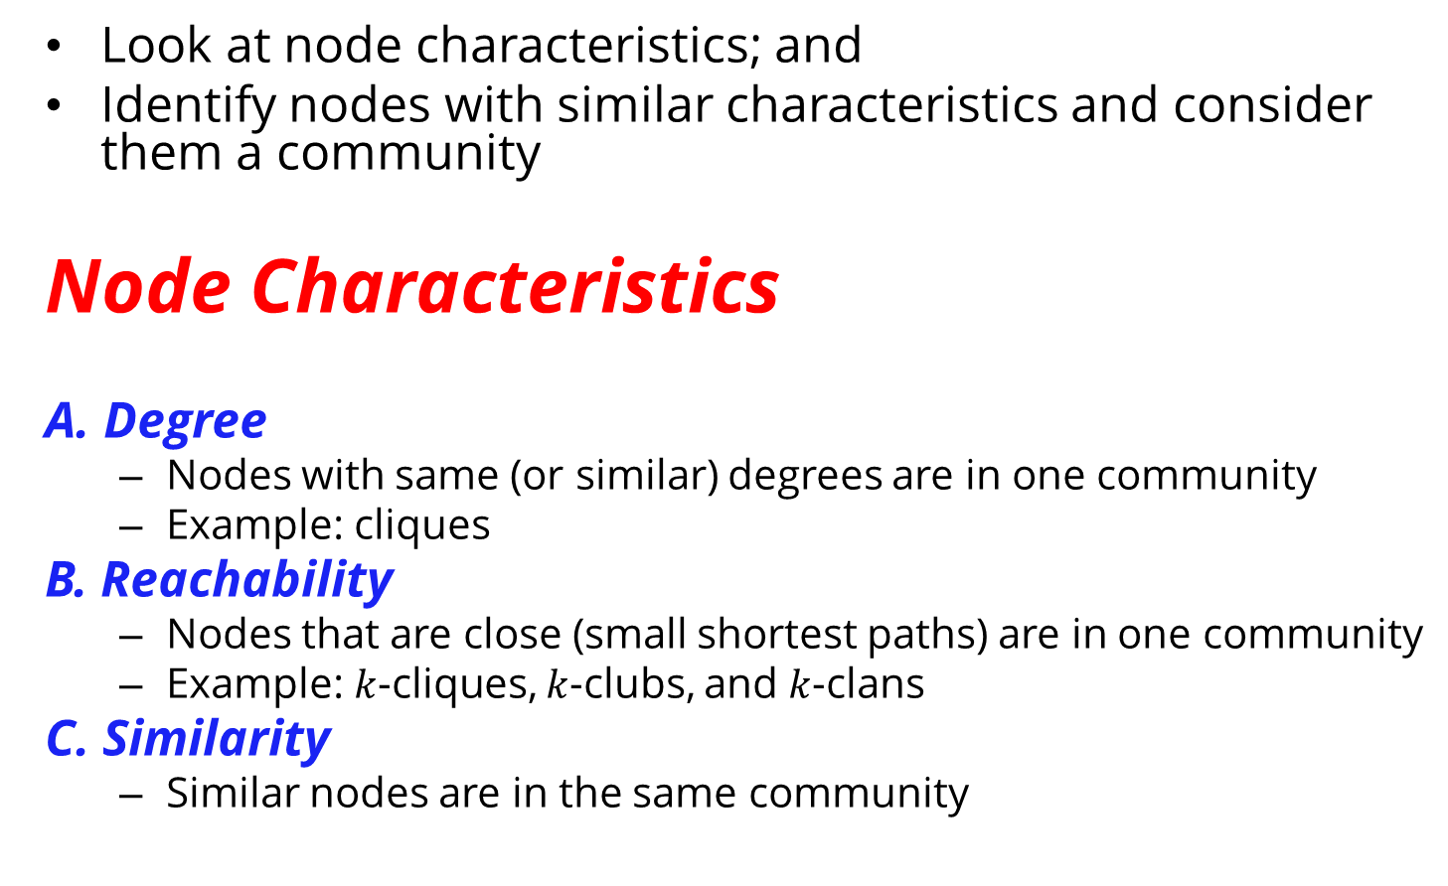
Member-Based Community Detection

Slide 19
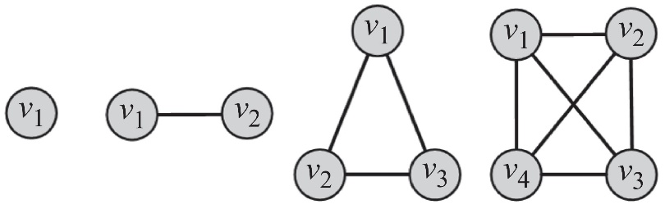
A. Node Degree
Most common subgraph searched for:
Clique: a maximum complete subgraph in which all nodes inside the subgraph adjacent to each other
Find communities by searching for
The maximum clique: the one with the largest number of vertices, or
All maximal cliques: cliques that are not subgraphs of a larger clique; i.e., cannot be further expanded
To overcome this, we can
Brute Force
Relax cliques
Use cliques as the core for larger communities
Both problems are NP-hard

Slide 20
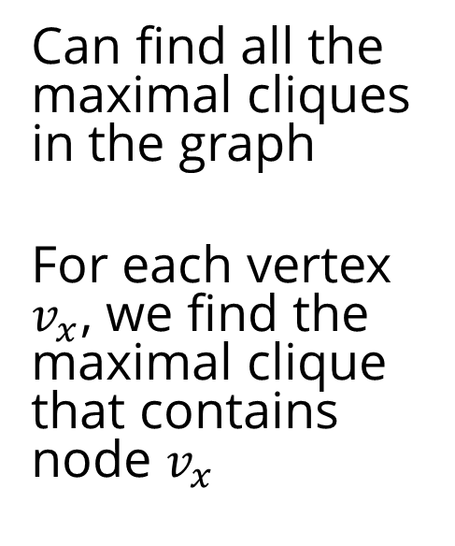
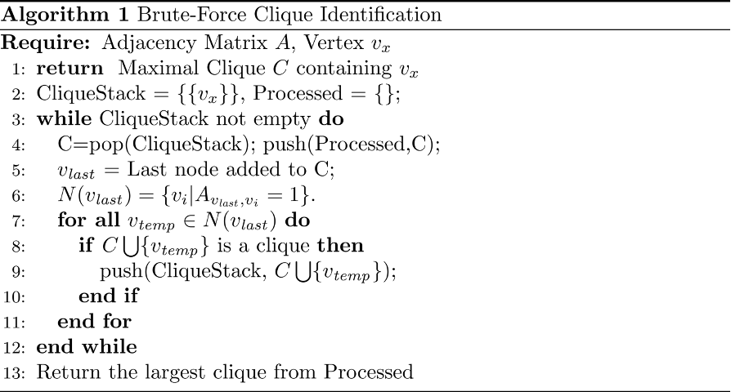
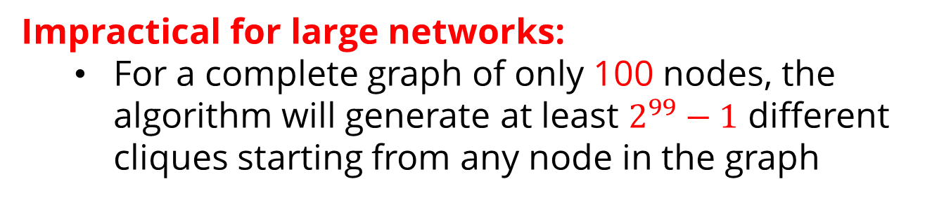
I. Brute-Force Method

Slide 21
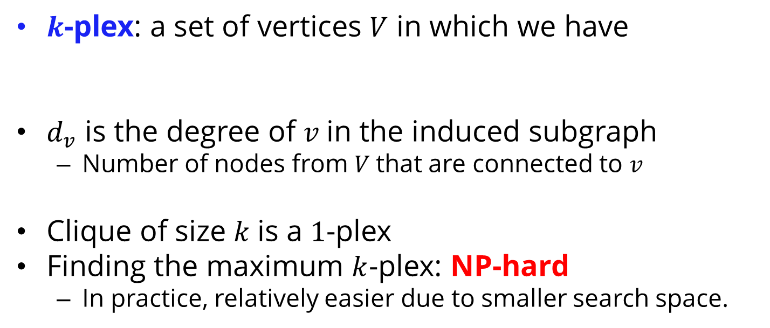
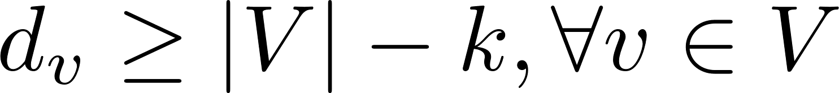
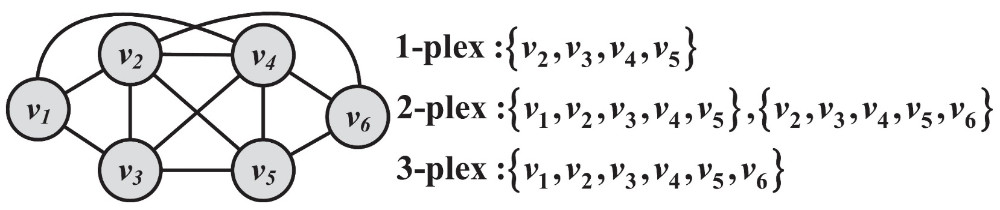

II. Relaxing Cliques

Slide 22
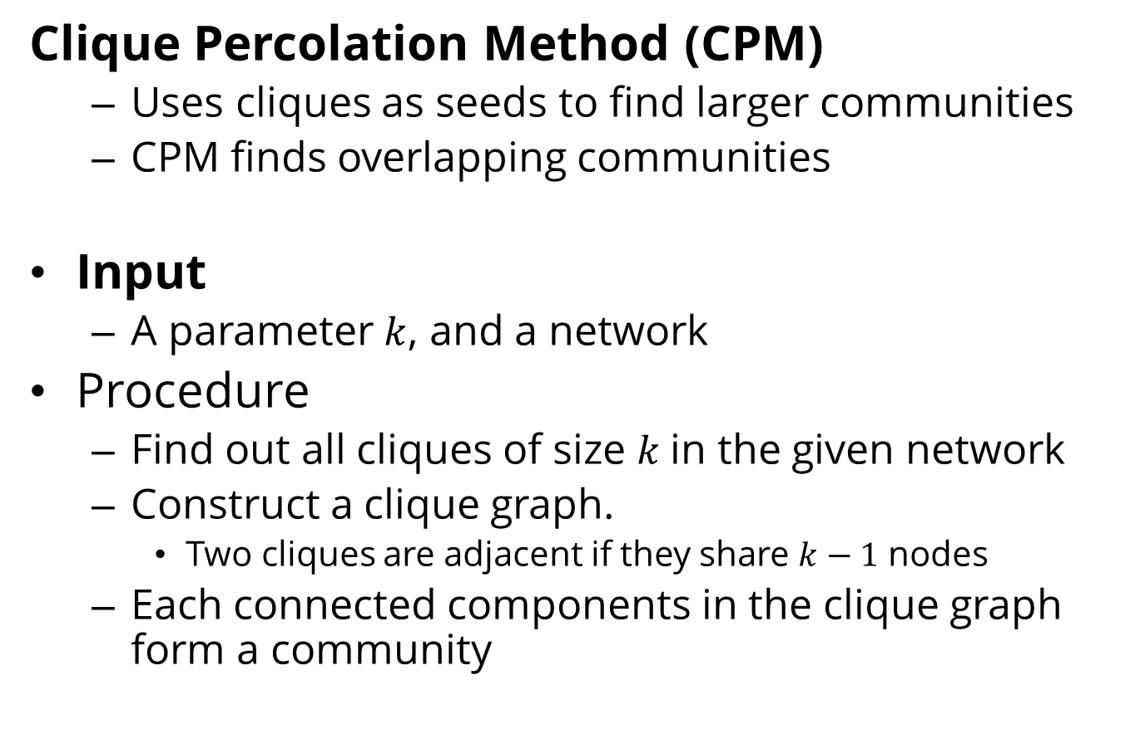
III. Using Cliques as a seed of a Community

Slide 23
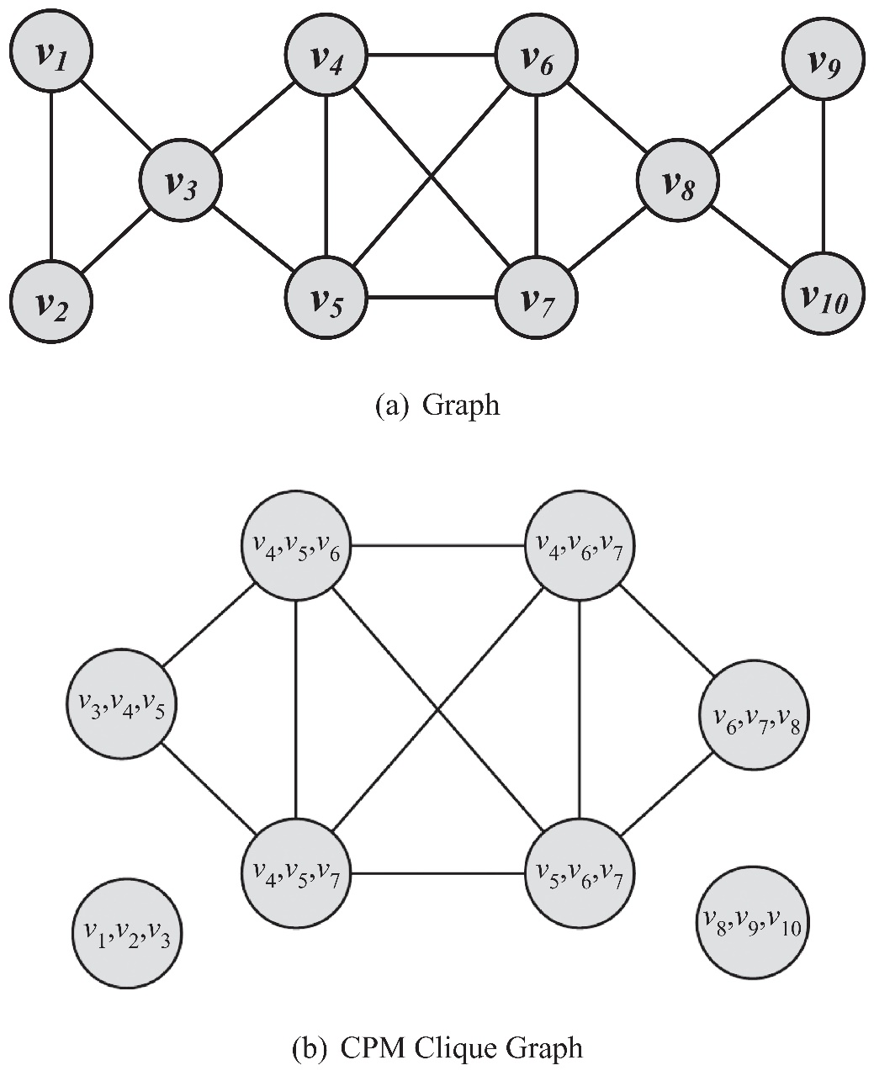
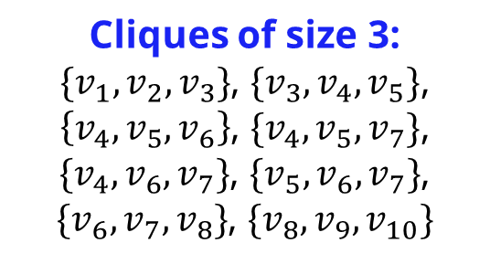
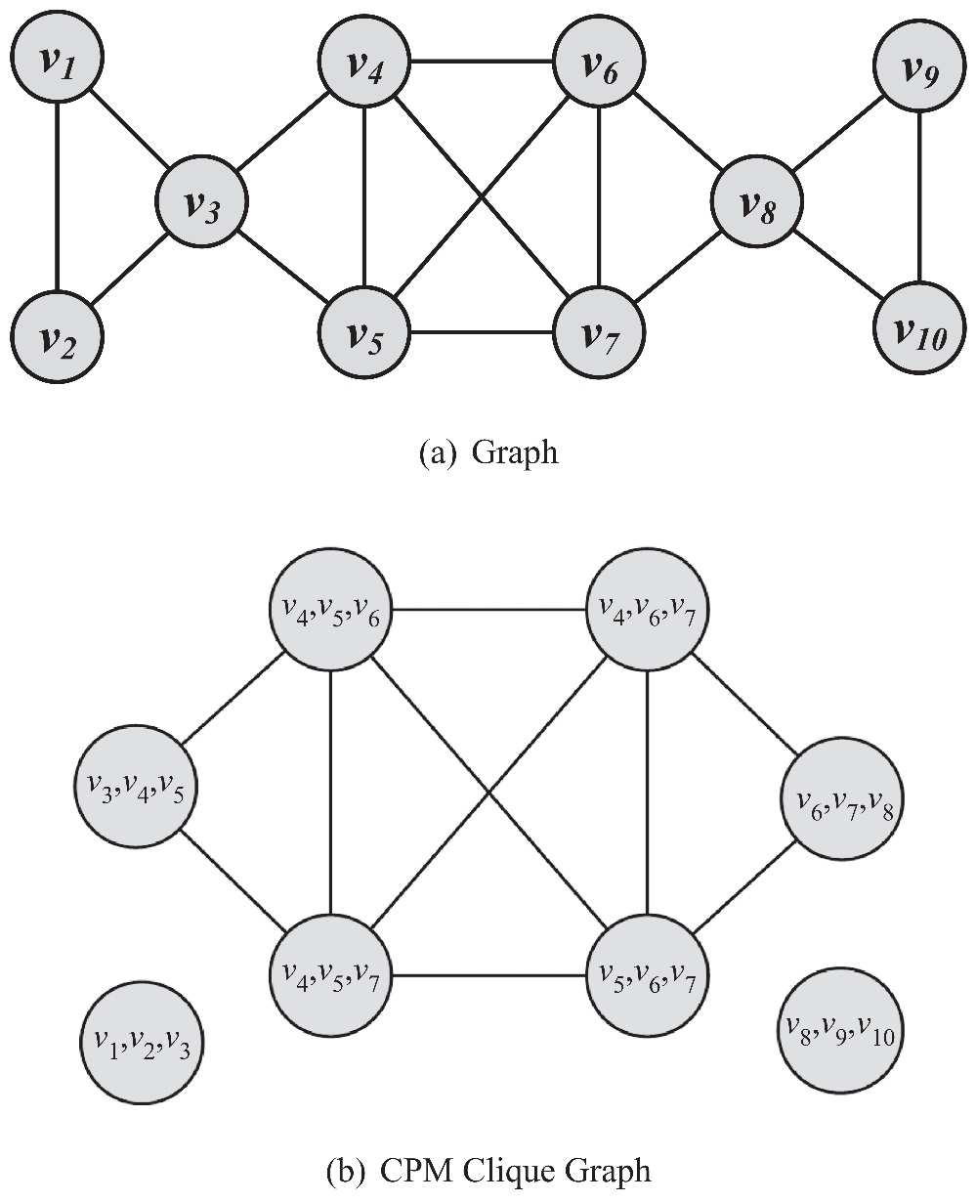
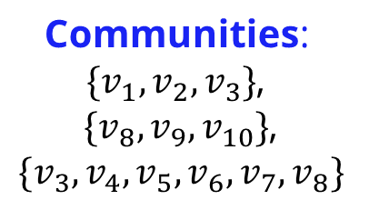
Clique Percolation Method: Example

Slide 24
B. Node Reachability
The two extremes
Nodes are assumed to be in the same community
If there is a path between them (regardless of the distance) or
They are so close as to be immediate neighbors.
How? Find using BFS/DFS
Challenge: most nodes are in one community (giant component)
How? Finding Cliques
Challenge: Cliques are challenging to find and are rarely observed
Solution: find communities that are in between cliques and connected components in terms of connectivity and have small shortest paths between their nodes

Slide 25
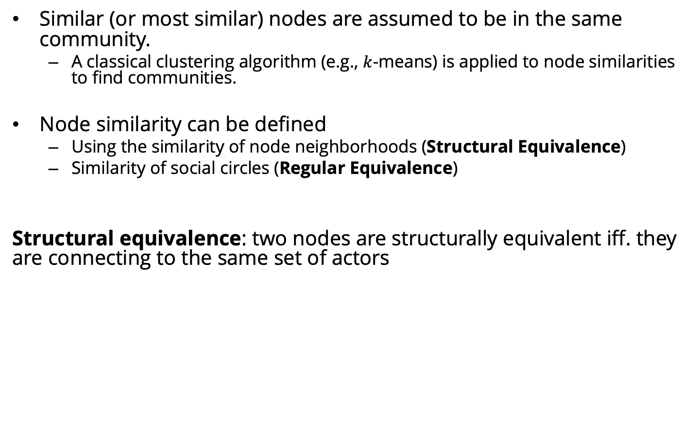
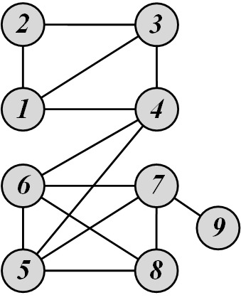
C. Node Similarity
Nodes 1 and 3 are structurally equivalent,
So are nodes 5 and 7.

Slide 26
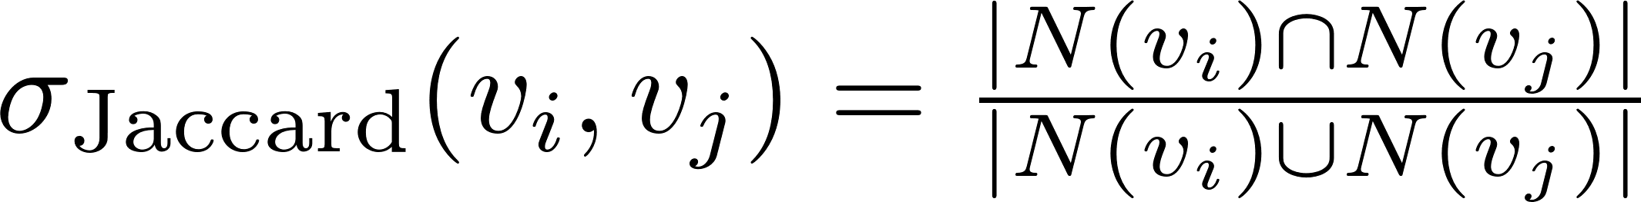
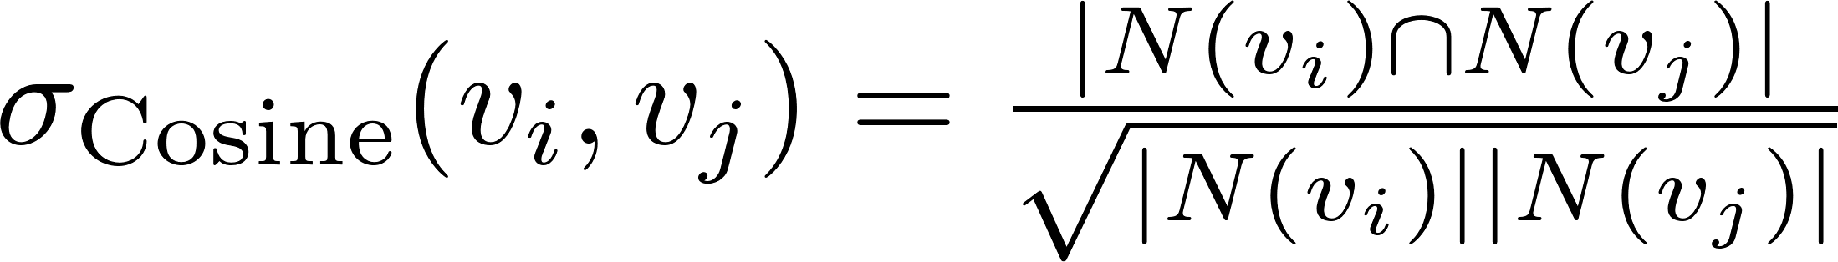
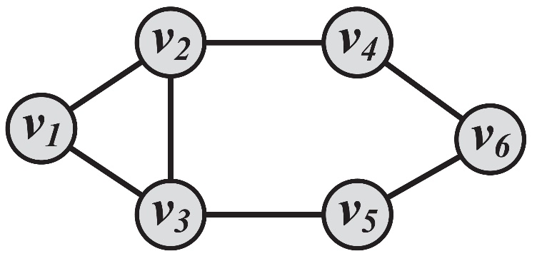
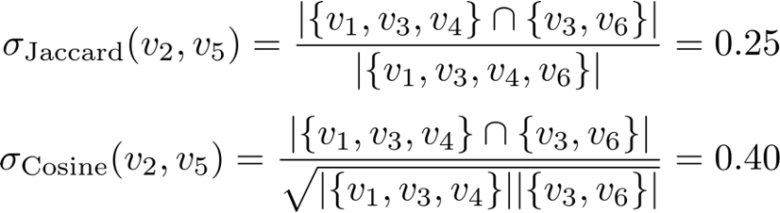
Node Similarity (Structural Equivalence)
Jaccard Similarity
Cosine similarity
Notes:
A is an adjacency matrix

Slide 27
Group-Based Community Detection

Slide 28
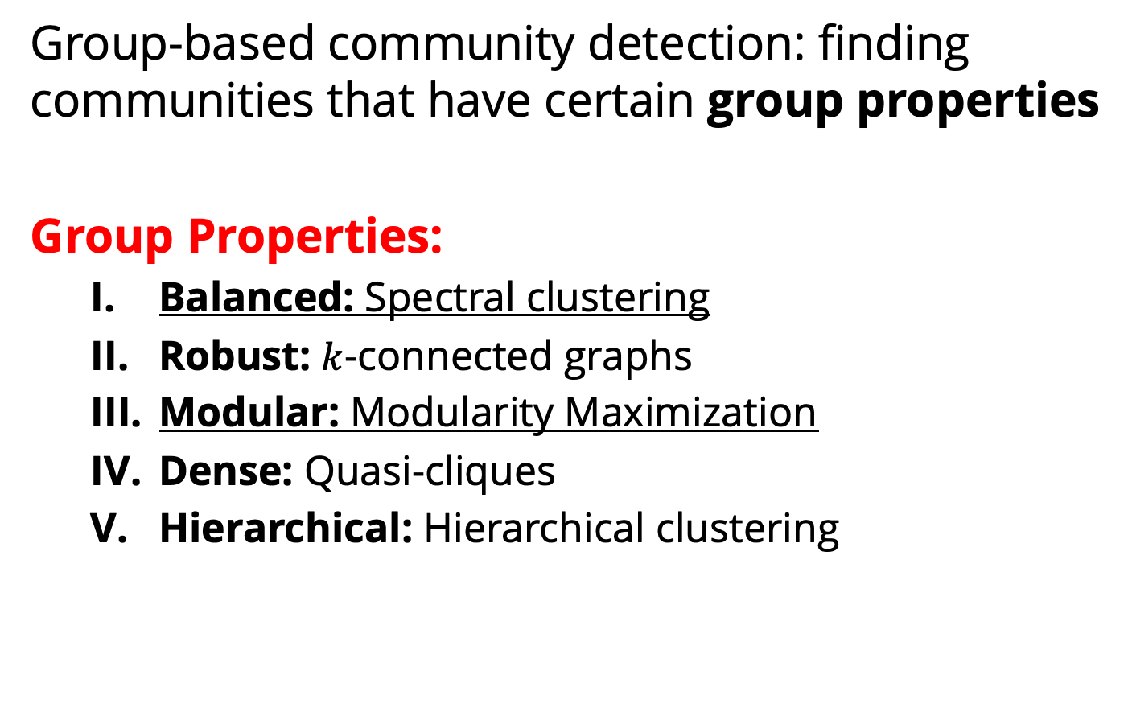
Group-Based Community Detection

Slide 29
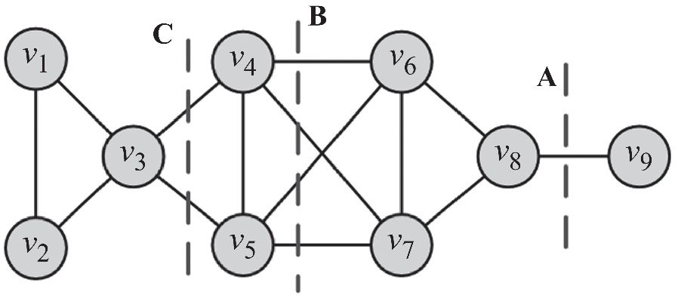
I. Balanced Communities
Community detection can be thought of graph clustering
Graph clustering: we cut the graph into several partitions and assume these partitions represent communities
Cut: partitioning (cut) of the graph into two (or more) sets (cutsets)
The size of the cut is the number of edges that are being cut
Minimum cut (min-cut) problem: find a graph partition such that the number of edges between the two sets is minimized
Min-cut
Min-cut often returns an imbalanced partition, with one set being a singleton

Slide 30
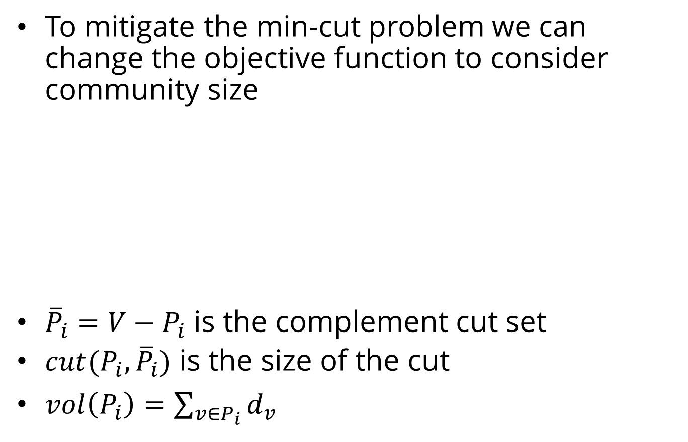
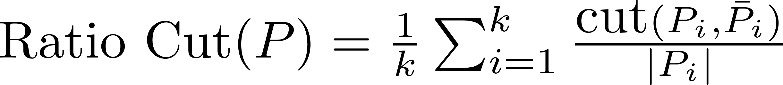
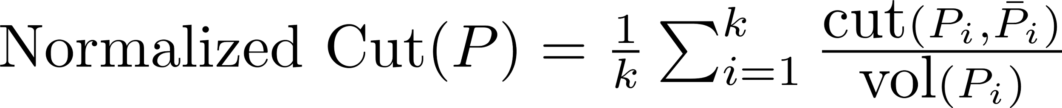
Ratio Cut and Normalized Cut

Slide 31
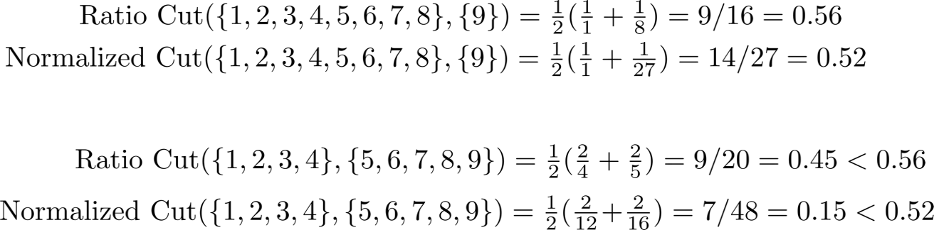
Ratio Cut & Normalized Cut: Example
B
A
For Cut A
For Cut B
Both ratio cut and normalized cut prefer a balanced partition

Slide 32
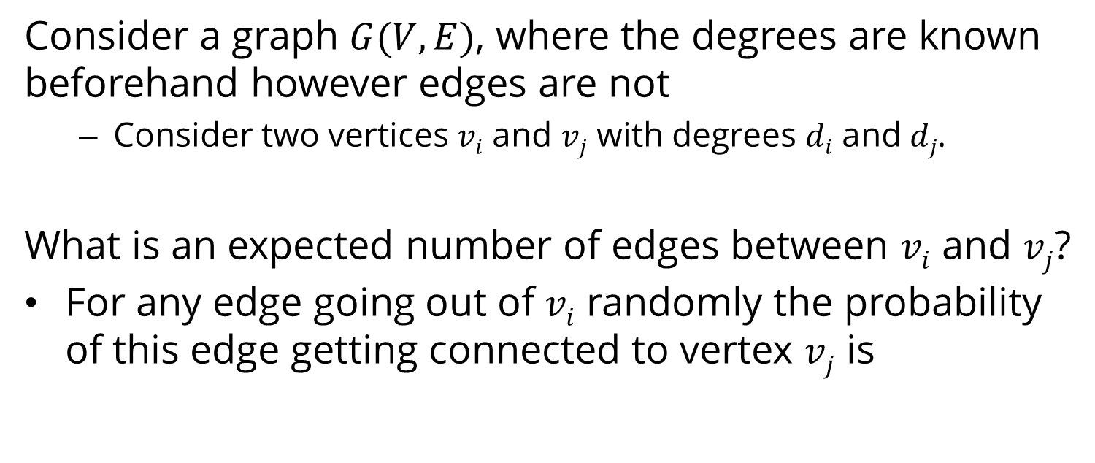
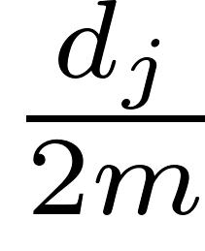
II. Modular Communities

Slide 33
Modularity and Modularity Maximization
Given a degree distribution, we know the expected number of edges between any pairs of vertices
We assume that real-world networks should be far from random. Therefore, the more distant they are from this randomly generated network, the more structural they are.
Modularity defines this distance and modularity maximization tries to maximize this distance

Slide 34

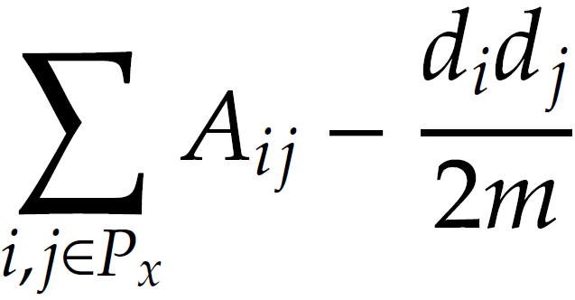
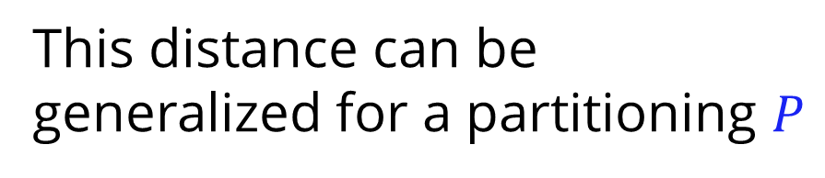
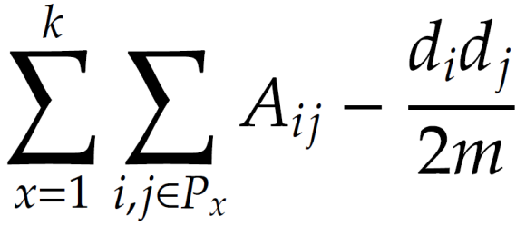
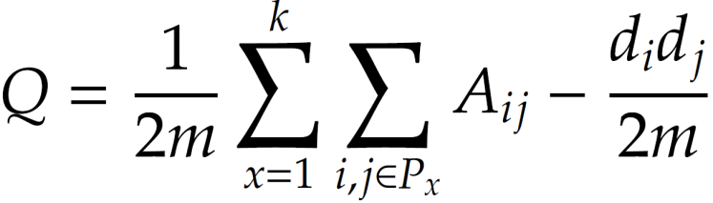
Normalized Modularity
The normalized version of this distance is defined as Modularity

Slide 35
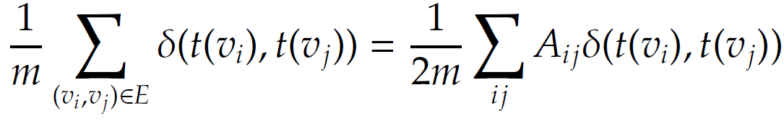
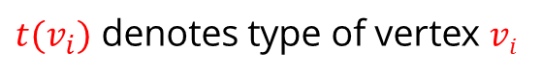
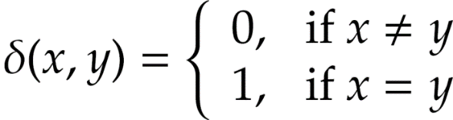
Recall: Measuring Assortativity for Nominal Attributes
Assume nominal attributes are assigned to nodes
Example: race
Edges between nodes of the same type can be used to measure assortativity of the network
Same type = nodes that share an attribute value
Node attributes could be nationality, race, sex, etc.
Kronecker delta function

Slide 36
Assortativity Significance
Assortativity significance
The difference between measured assortativity and expected assortativity
The higher this difference, the more significant the assortativity observed
Example
In a school, 50% of the population is white and the other 50% is hispanic.
We expect 50% of the connections to be between members of different races.
If all connections are between members of different races, then we have a significant finding

Slide 37
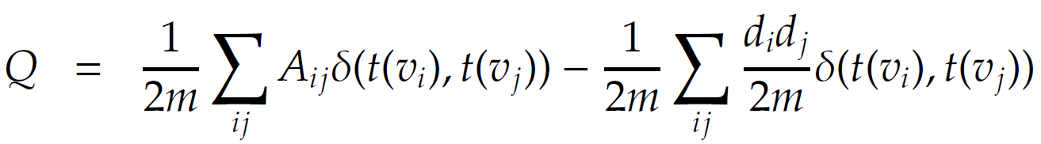
Assortativity Significance
Assortativity
Expected assortativity
(according to configuration model)
This is modularity
Notes:
d_i is degree for v_i
For any edge coming out of node i randomly, the probability of it hitting node j is d_j/2m.
We get d_i trials since node i has d_i links.
Multiply by the delta to get the probability of them being of the same type.

Slide 38
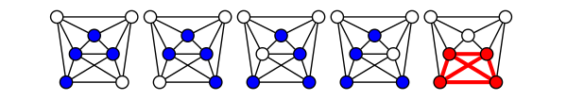
How do we maximize modularity?
Intuition: maximizing Q is hard
Imagine communities as dense subgraph
Simplest dense subgraph: all-to-all (cliques)
This is NP-hard
NP-Complete

Slide 39
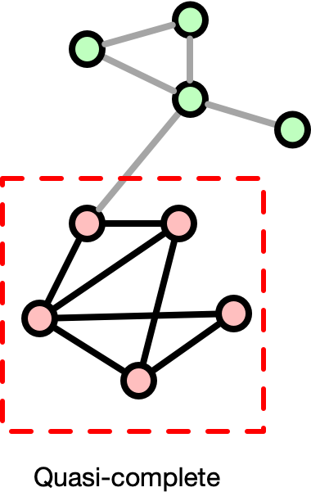

Simplifying the problem
What about a quasi-complete subgraph? i.e., almost-all-to-all subgraph?
NP-Complete

Slide 40

Many communities have similar modularity

Slide 41

Modularity Optimization
Assume greedy algorithm is good enough
Louvain Method
A greedy modularity optimization method for community detection
Invented when all authors affiliated with Université catholique de Louvain (UCL)

Slide 42

Louvain Method
The algorithm has multiple passes
Each pass has two phases
Modularity Optimization
Community Aggregation
Image from Blondel, Vincent D., Jean-Loup Guillaume, Renaud Lambiotte, and Etienne Lefebvre. "Fast unfolding of communities in large networks." Journal of statistical mechanics: theory and experiment 2008, no. 10 (2008): P10008.

Slide 43

Louvain Method

Slide 44
Important Points about Phase I
A point can be considered multiple times
A Local Minima of modularity maximization is achieved in phase I
Phase I is order dependent
The modularity achieved is more or less stable and is less dependent on the initial order
The computation time depends on the initial order.

Slide 45

Louvain Method

Slide 46

Application

Slide 47

Example clusters
Within clusters, everyone comes from same ancestor (share long DNA segment)
Clusters should be all-to-all (everyone within cluster is shares same DNA with everyone else)

Slide 48

Want high node connectivity (all-to-all cliques)

Slide 49

Assume:
Extra links between any pair of nodes
Missing links

Slide 50

Finding correct partition: maximum likelihood
Heuristic to approximate random links (e) then change partitions of A and B

Slide 51
How well does this work?
Best method among all comparable models
Highest accuracy in simulated data
Note this is a special case
No social networks are all-to-all
Often social network overlap (e.g., friends in baseball team and college) complicating picture
Conclusion
Don’t use method for social networks
But it showcases how special models better explain/clean data

Slide 52
Other methods
Ways to solve NP-hard problems can be used to find the best communities:
Genetic algorithms
Simulated annealing
Heuristics, e.g., extremal optimization: O(n^2 log(n))
Relaxing the problem
Replace delta function (0 or 1) with real value
Spectral optimization:
Mapping networks to eigenvalues/vectors (linear algebra)
Partitioning nodes embedding in this space

Slide 53

Spectral clustering

Slide 54

Examples of relative speed

Slide 55

Community Detection Algorithms

Slide 56
Community Evaluation

Slide 57


Evaluating the Communities
Evaluation with ground truth
Evaluation without ground truth

Slide 58
Evaluation with Ground Truth
When ground truth is available
We have partial knowledge of what communities should look like
We are given the correct community (clustering) assignments
Measures
Precision and Recall, or F-Measure
Purity
Mutual Information
Notes:
TP – the intersection of the two oval shapes; TN – the rectangle minus the two oval shapes; FP – the circle minus the blue part; FN – the blue oval minus the circle. Accuracy = (TP+TN)/(TP+FP+FN+FN); Precision = TP/(TP+FP); Recall = TP/(TP+FN)

Slide 59




Purity
We can assume the majority of a community represents the community
We use the label of the majority against the label of each member to evaluate the communities
Purity. The fraction of instances that have labels equal to the community’s majority label
Purity can be easily tampered by
Points being singleton communities (of size 1); or by
Very large communities
Notes:
N – the total number of data points.

Slide 60

Mutual information or statistical power
Other options include (normalized) mutual information or statistical power
Optional HW problem: create a random graph and partition it. Calculate NMI
These metrics increase with more (false) clusters (Adjusted MI is better!)

Slide 61

Evaluation without Ground Truth
Evaluation with Semantics
A simple way of analyzing detected communities is to analyze other attributes (posts, profile information, content generated, etc.) of community members to see if there is a coherency among community members
The coherency is often checked via human subjects.
Or through labor markets.
To help analyze these communities, one can use word frequencies. By generating a list of frequent keywords for each community, human subjects determine whether these keywords represent a coherent topic.
Evaluation Using Clustering Quality Measures
Use clustering quality measures (SSE)
Use more than two community detection algorithms and compare the results and pick the algorithm with better quality measure

Slide 62
Evaluate with Modularity?
Often modularity used to evaluate without GT
(May be bad): resolution limit
Create graph with all-to-all subgraphs
Connect subgraphs with 1 link
If cliques > sqrt(|E|) (more than square root of the number of edges): combining cliques increases modularity
This means modularity ignores cliques that are too small

Slide 63

Example

